Slide 1

Computer Organization & Architecture
ECE 2002
Dr. S Saritha
Associate Professor
SENSE

Slide 2
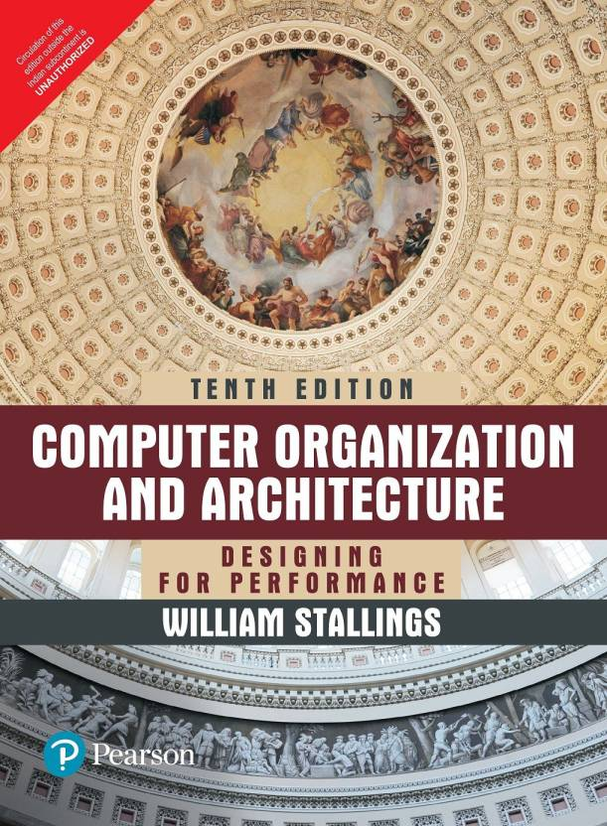
Text Book: William Stallings, Computer Organization and Architecture: Designing for Performance, Pearson Education, Tenth Edition,2013
Books:
1. M. Morris Mano, Rajib Mall, Computer System Architecture, Pearson Education Third Edition,2017.
2. Carl Hamacher, Zvonkovranesic, Safwat Zaky , Computer Organization, McGraw Hill, Fifth Edition,2011.

Slide 3
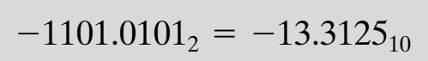
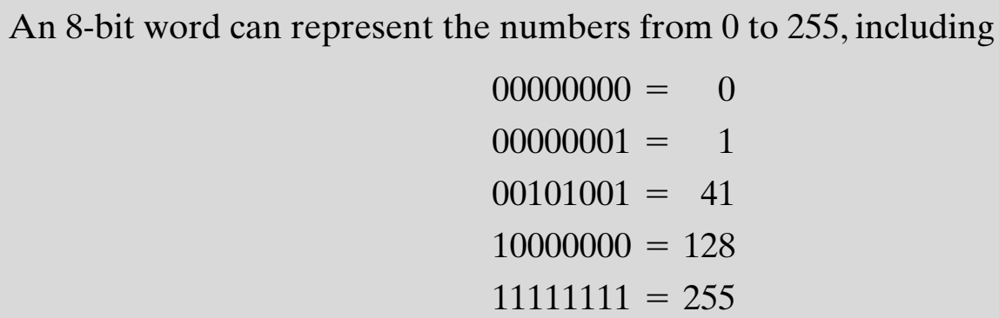
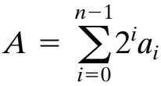
Integer representation
Arbitrary numbers can be represented with just the digits zero and one, the minus sign, and the period
For computer storage and processing → minus signs and periods cannot be used
Only binary digits (0 and 1) may be used to represent numbers
If limited to non-negative integers, the representation is straightforward

Slide 4
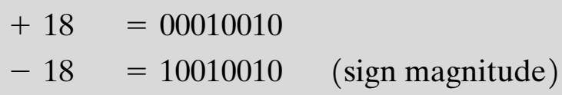
Sign-Magnitude representation
There are several conventions used to represent negative as well as positive integers → all of which involve treating the most significant (leftmost) bit in the word as a sign bit.
If the sign bit is 0 → the number is positive; if the sign bit is 1 → the number is negative
The simplest form of representation that employs a sign bit is the sign-magnitude representation
In an n-bit word, the rightmost bits hold the magnitude of the integer

Slide 5
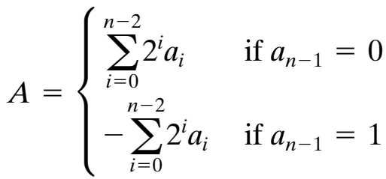
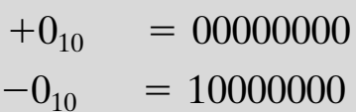
Sign-Magnitude representation
General case
DRAWBACKS
Addition and subtraction requires consideration of both the signs of the numbers and their relative magnitudes to carry out the required operation
Another drawback is that there are two representations of 0

Slide 6
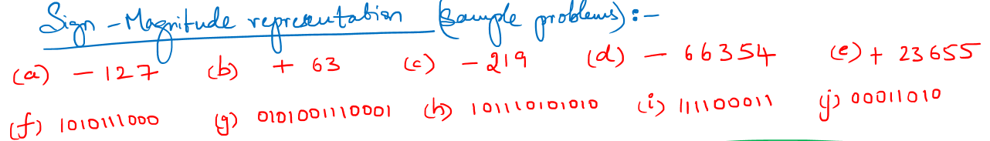

Slide 7
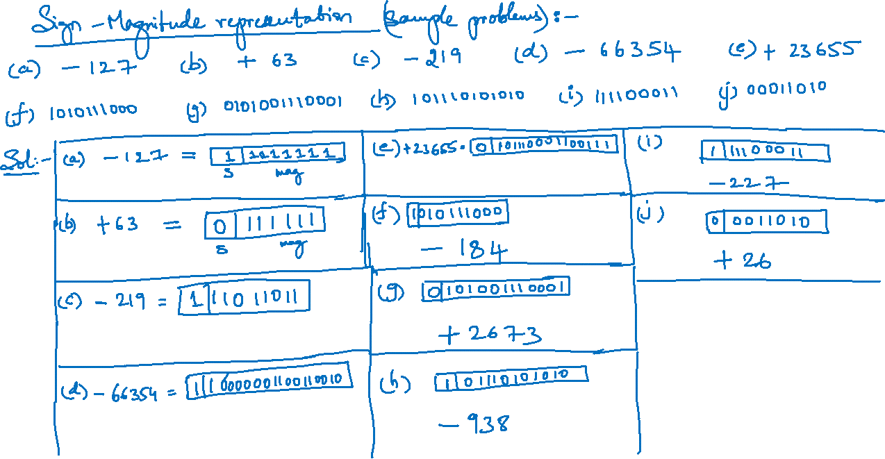

Slide 8
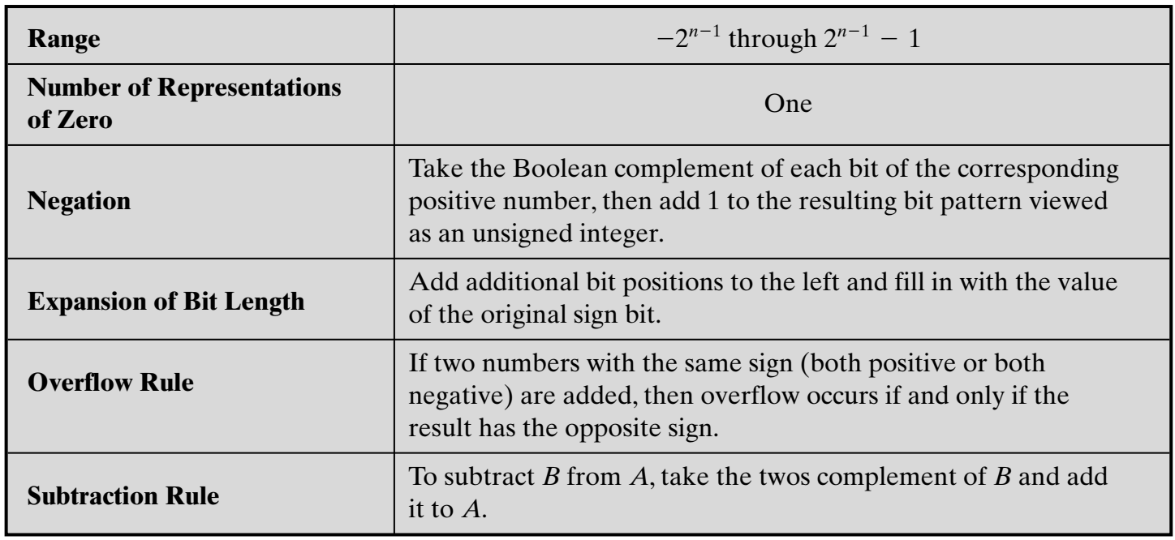
2’s complement representation
2’s complement representation also uses the MSB as a sign bit

Slide 9
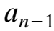
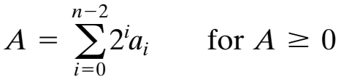
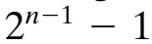
2’s complement representation
Consider an n-bit integer, A, in 2’s complement representation
If A is positive, then the sign bit, is zero. The remaining bits represent the magnitude of the number in the same fashion as for sign magnitude representation
The number zero is identified as positive and therefore has a 0 sign bit and a magnitude of all 0s.
The range of positive integers that may be represented is from 0 (all of the magnitude bits are 0) through (all of the magnitude bits are 1).
Any larger number would require more bits

Slide 10
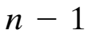
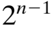
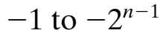
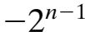
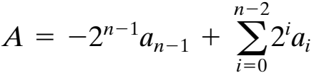
2’s complement representation
Now, for a negative number the sign bit, is one
The remaining bits can take on any one of values
Therefore, the range of negative integers that can be represented is from
The weight of the most significant bit is
This is the convention used in 2’s complement representation, yielding the following expression for negative numbers

Slide 11
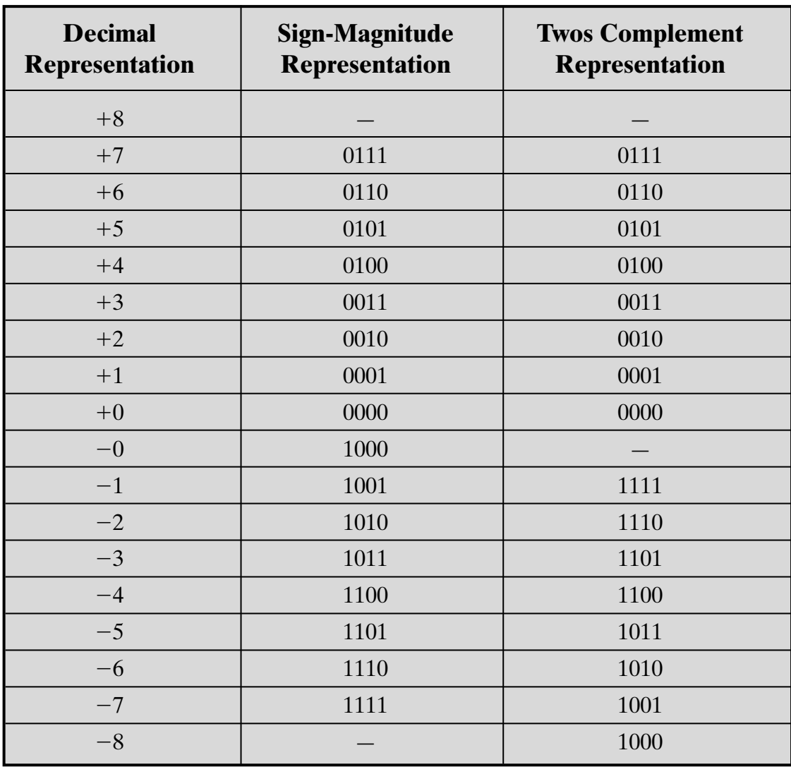
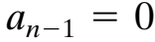
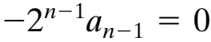
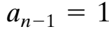
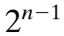
2’s complement representation
For , the term and the equation defines a non-negative integer
When , the term is subtracted from the summation term, yielding a negative integer

Slide 12
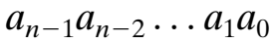
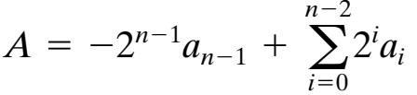
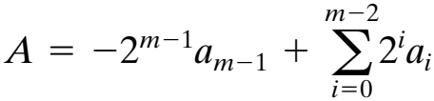
Working
Consider an n-bit sequence of binary digits interpreted as a 2’s complement integer A, so that its value is
If A is a positive number, the rule clearly works. Now, if A is negative and we want to construct an m-bit representation, with m > n. Then

Slide 13
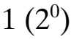
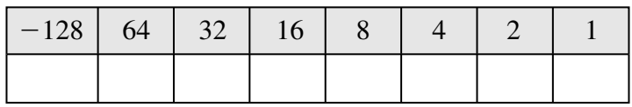
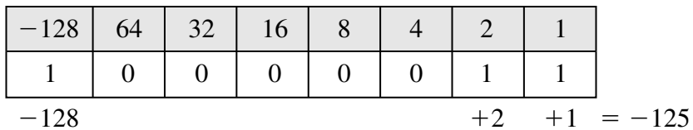
2’s complement using value box representation
The nature of 2’s complement representation is a value box, in which the value on the far right in the box is
Each succeeding position to the left is double in value, until the leftmost position, which is negated
The most negative 2’s complement number that can be represented is i.e. if any of the bits other than the sign bit is one, it adds a positive amount to the number

Slide 18
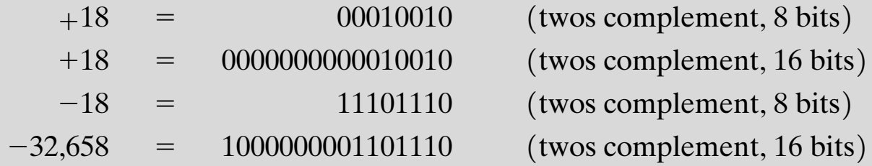
Converting between different bit lengths
It is sometimes desirable to take an n-bit integer and store it in m bits, where m > n
In sign-magnitude notation, this is easily accomplished: simply move the sign bit to the new leftmost position and fill in with zeros.
For 2’s complement negative numbers

Slide 19
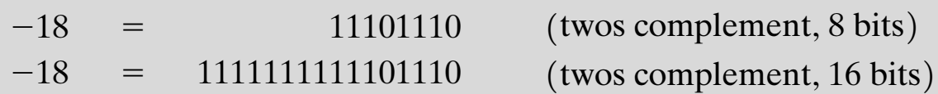
Converting between different bit lengths
The rule for 2’s complement integers is to move the sign bit to the new leftmost position and fill in with copies of the sign bit.
For positive numbers, fill in with zeros, and for negative numbers, fill in with ones. This is called sign extension.

Slide 20
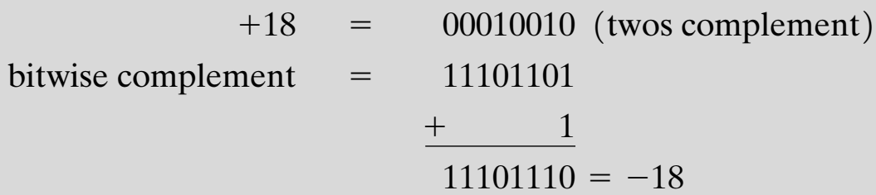
Integer arithmetic: negation
In sign-magnitude representation, the rule for forming the negation of an integer is simple: invert the sign bit
In 2’s complement notation,
Take the Boolean complement of each bit of the integer
Treating the result as an unsigned binary integer, add 1

Slide 21
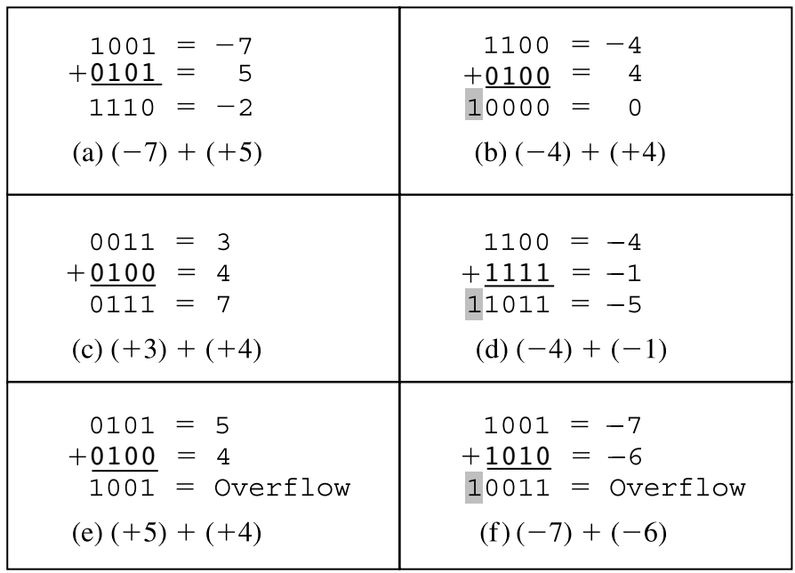
Integer arithmetic: Addition

Slide 22
Integer arithmetic: Addition

Slide 23
Integer arithmetic: Addition

Slide 24
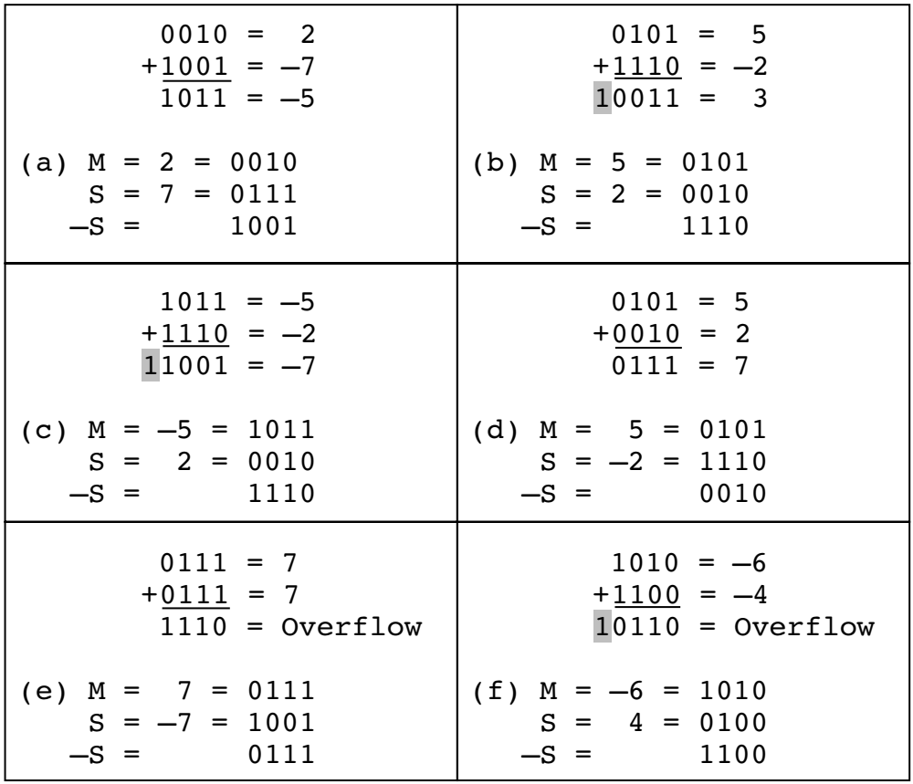
Integer arithmetic: subtraction

Slide 25
Integer arithmetic: subtraction

Slide 26
Integer arithmetic: subtraction

Slide 27
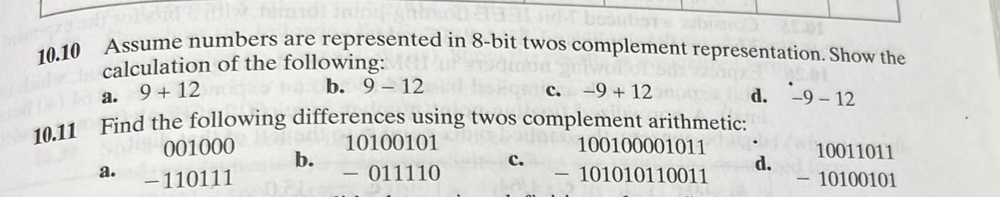

Slide 28
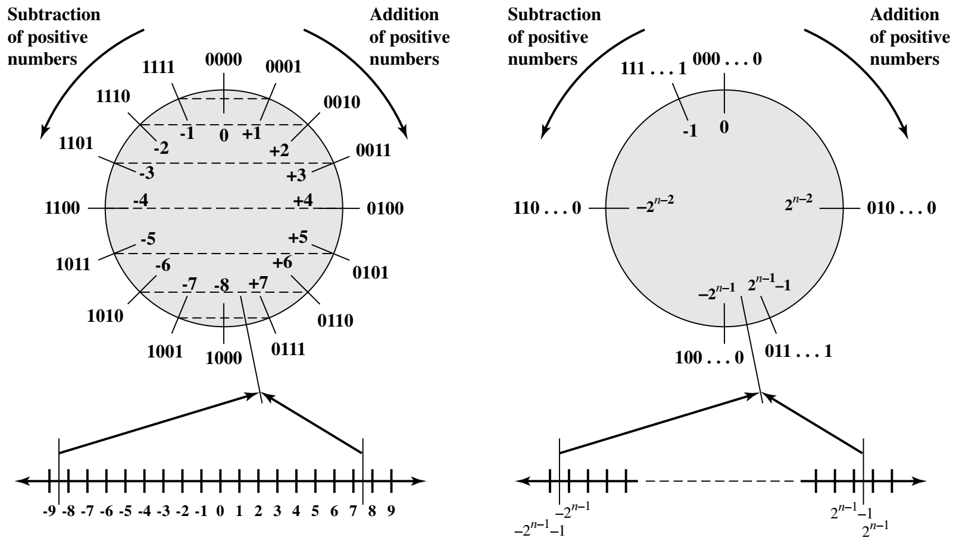
Geometric Depiction of Twos Complement Integers

Slide 29
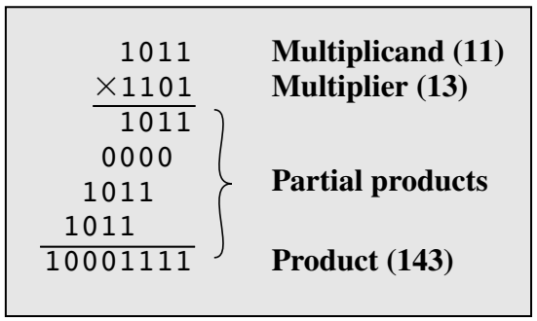
Integer arithmetic: multiplication
Compared with addition and subtraction, multiplication is a complex operation, whether performed in hardware or software
A wide variety of algorithms have been used in various computers
Multiplication of unsigned integers
Multiplication involves the generation of partial products, one for each digit in the multiplier. These partial products are then summed to produce the final product
The partial products are easily defined. When the multiplier bit is 0, the partial product is 0. When the multiplier bit is 1, the partial product is the multiplicand
The total product is produced by summing the partial products. For this operation, each successive partial product is shifted one position to the left relative to the preceding partial product
The multiplication of two n-bit binary integers results in a product of up to 2n bits in length (e.g., 11 x 11 = 1001)

Slide 30
Integer arithmetic: multiplication
Compared with the pencil-and-paper approach, there are several things we can do to make computerized multiplication more efficient
First, we can perform a running addition on the partial products rather than waiting until the end.
For each 1 on the multiplier, an add and a shift operation are required; but for each 0, only a shift is required.

Slide 31
Multiplication
Complex
Work out partial product for each digit
Take care with place value (column)
Add partial products

Slide 32
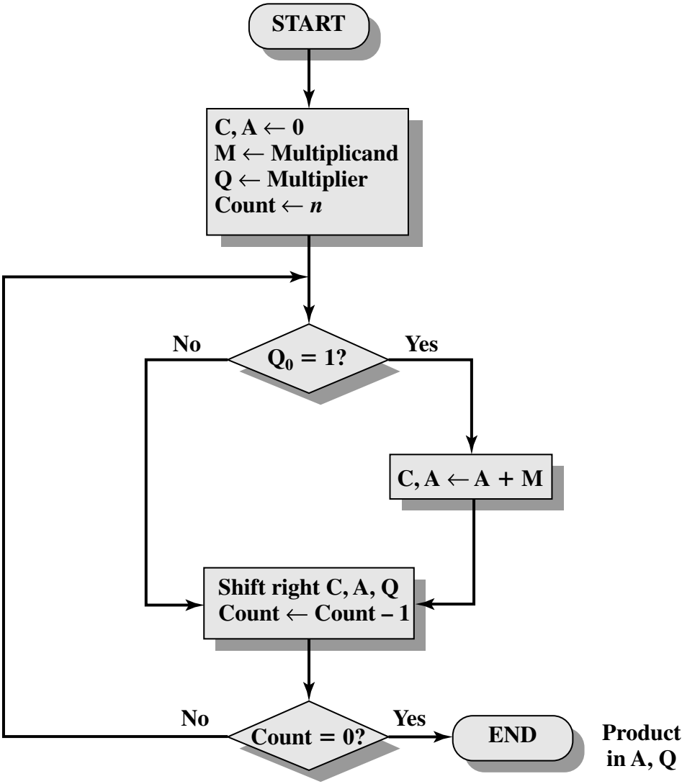
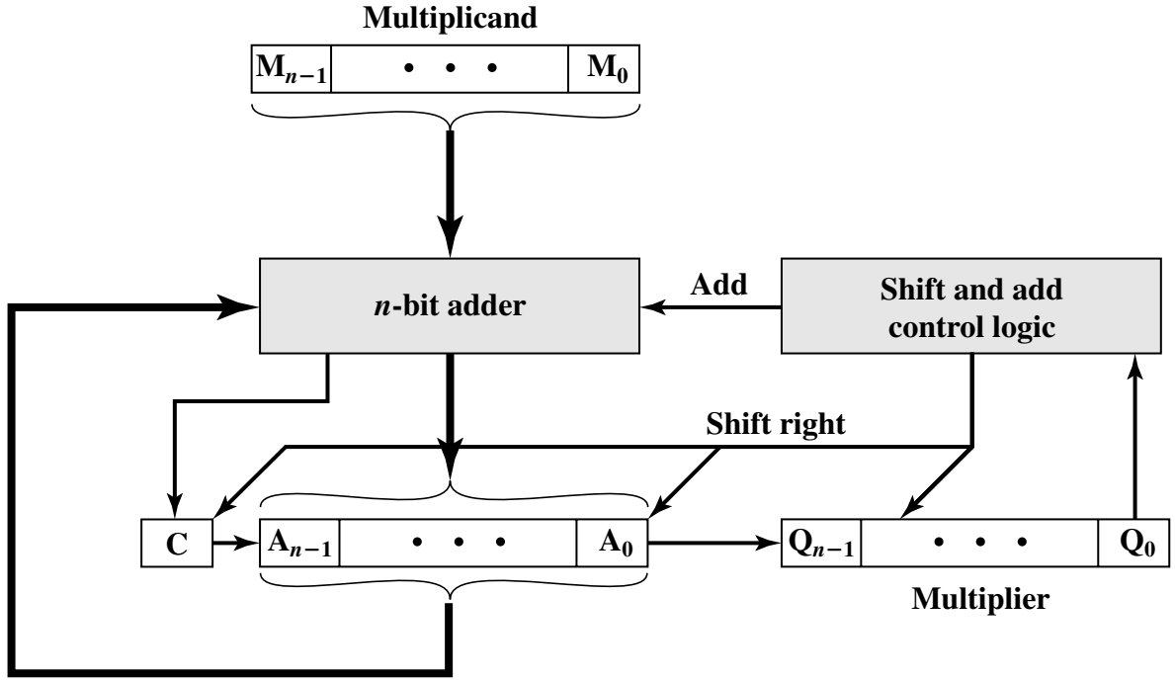
Multiplication

Slide 33
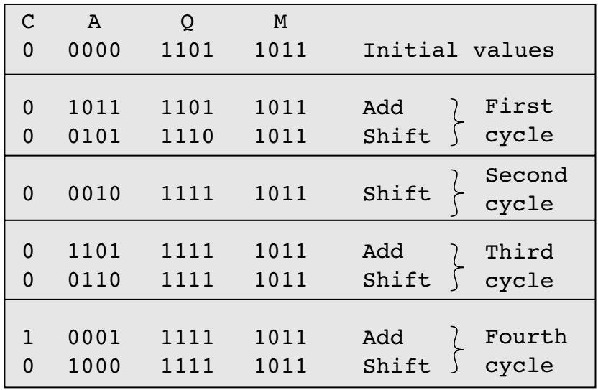

Slide 34
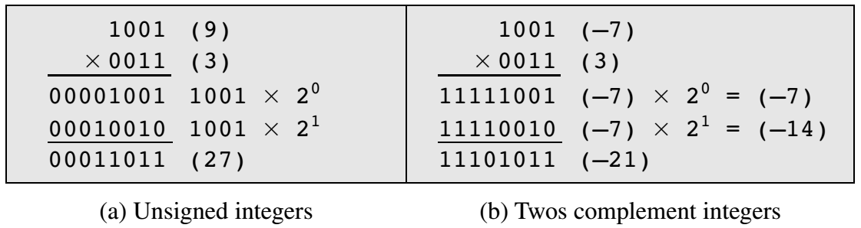
Multiplying Negative Numbers
This does not work! Eg. If we multiply 11 (1011) by 13 (1101) we should get 143 (10001111).
If we interpret these as two’s complement numbers, we have -5 (1011) times
-3(1101) which equals -113(10001111) which is incorrect.
It will also not work if either the multiplicand or the multiplier is negative.
If 9 and 3 are treated as unsigned integers, the multiplication proceeds simply fig a.
But if 1001 is interpreted as the
twos complement value -7,then each partial product must be a negative twos complement number of 2n(8) bits, as shown in Figure b.
Note: this is accomplished by padding out each partial product to the left with binary 1s

Slide 35
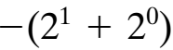
If the multiplier is negative
If the multiplier is negative, straightforward multiplication also will not work.
The reason is that the bits of the multiplier no longer correspond to the shifts or multiplications that must take place.
For example, the 4-bit decimal number -3 is written 1101 in twos complement. If we simply took partial products based on each bit position, we have
instead of

Slide 36
Solutions to the above issues
Solution 1
Convert to positive if required
Multiply as above
If signs were different, negate answer
Solution 2
Booth’s algorithm

Slide 37
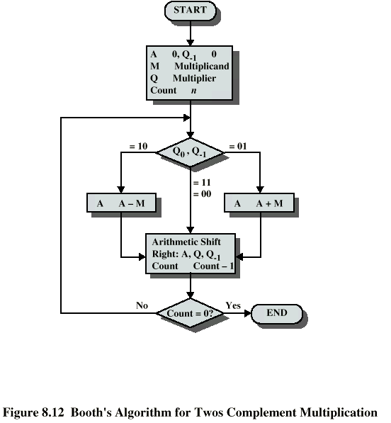
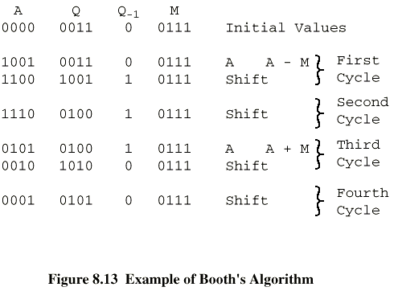
Booth’s Algorithm with example

Slide 38
Description of the algorithm
As before, the multiplier and multiplicand are placed in the Q and M registers, respectively.
There is also a 1-bit register placed logically to the right of the least significant bit of the Q register and designated its use is explained shortly.
The results of the multiplication will appear in the A and Q registers.
A and Q₋₁ are initialized to 0. As before, control logic scans the bits of the multiplier one at a time.
Now, as each bit is examined, the bit to its right is also examined.
If the two bits are the same (1–1 or 0–0), then all of the bits of the A, Q, and Q₋₁ registers are shifted to the right by 1 bit. If the two bits differ, then the multiplicand is added to or subtracted from the A register, depending on whether the two bits are 0–1 or 1–0.
Following the addition or subtraction, the right shift occurs. In either case, the right shift is such that the leftmost bit of A, namely A_{n-1}not only is shifted into A_{n-2} but also remains in A_{n-1}
This is required to preserve the sign of the number in A and Q. It is known as an arithmetic shift, because it preserves the sign bit.
Finally, the result is at A and Q registers.

Slide 39
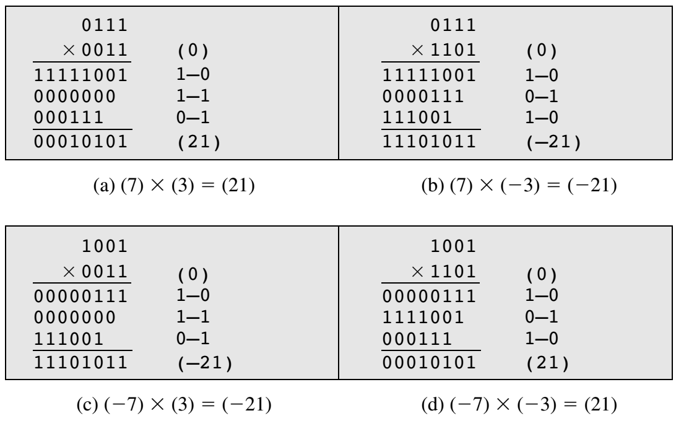
Some more examples
Note: For Q_{n} and Q_{n-1}
If 1-1/0-0 the value of A will not change ie. Will remain 0000
If 1-0, A=A-M= 0000-0111=1001
If 0-1, A=A+M= 0000+0111=0111
But for each positive intermediate value, 0s will be appended at left and for negative value, 1s will be appended at the left side.

Slide 40
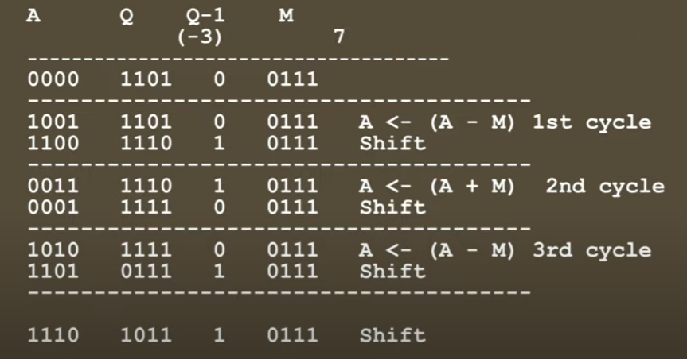
EXAMPLE: 7X(-3)

Slide 41
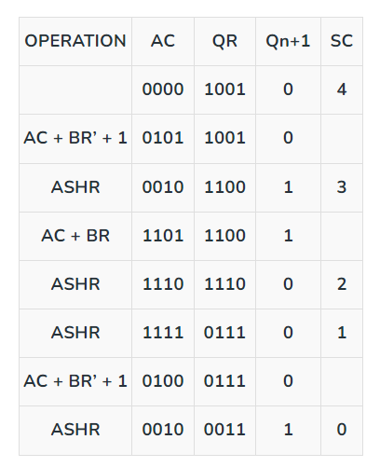
EXAMPLE: (-5)X(-7)

Slide 42
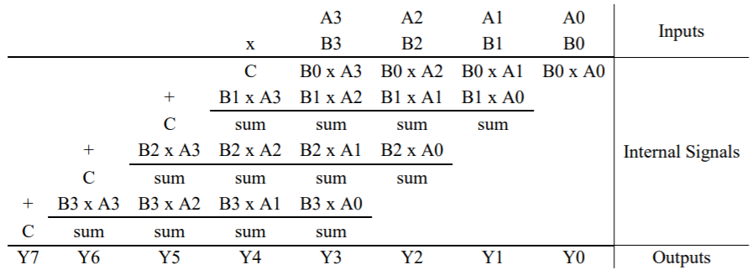
Array multiplication
Let us consider the multiplicand to be M = (A₃, A₂, A₁, A₀) and the multiplier to be Q = (B₃, B₂, B₁, B₀)

Slide 43
Array multiplication
Let us consider the multiplicand to be M = (a₃, a₂, a₁, a₀) and the multiplier to be Q = (b₃, b₂, b₁, b₀)

Slide 44
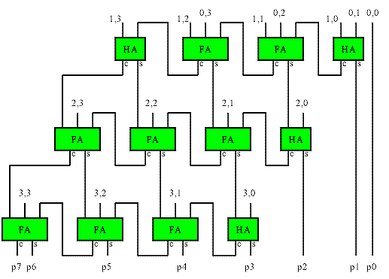
Hardware configuration of 4*4 Array multiplier
For m-bit*n-bit multiplier we need m*n AND gates, n Half adders, and (m-2)*n Full adders

Slide 45
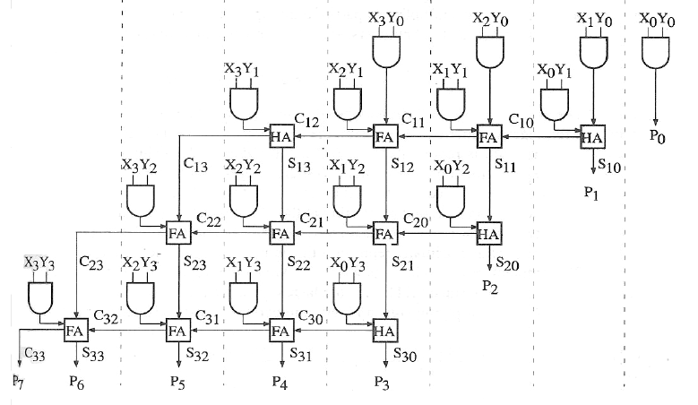
Hardware configuration of 4*4 Array multiplier
For m-bit*n-bit multiplier we need m*n AND gates, n Half adders, and (m-2)*n Full adders

Slide 46


Signed multiplication using array multiplier

Slide 47
Division
More complex than multiplication
Negative numbers are really bad!
Based on long division

Slide 48
Division of Unsigned Binary Integers
First, the bits of the dividend are examined from left to right, until the set of bits examined represents a number greater than or equal to the divisor; this is referred to as the divisor being able to divide the number.
Until this event occurs, 0s are placed in the quotient from left to right.
When the event occurs, a 1 is placed in the quotient and the divisor is subtracted from the partial dividend. The result is referred to as a partial remainder.
This process is carried out in cyclic manner. At each cycle, additional bits from the dividend are appended to the partial remainder until the result is greater than or equal to the divisor.
As before, the divisor is subtracted from this number to produce a new partial remainder.
The process continues until all the bits of the dividend are exhausted.
00001101
Quotient
Divisor
1011
10010011
Dividend
1011
001110
Partial
Remainders
1011
001111
1011
Remainder
100

Slide 49


Flowchart for Unsigned Binary Division Restoring Algorithm
Example of Restoring Twos Complement Division (7/3)
M=0011

Slide 50
Procedure
In the 1st step, the A and Q registers together are shifted to the left 1 bit.
M is subtracted from A to determine whether A divides the partial remainder.
If it does, then Q₀ gets a 1 bit. Otherwise, Q₀ gets a 0 bit and M must be added back to A to restore the previous value. The count is then decremented, and the process continues for n steps.
At the end, the quotient is in the Q register and the remainder is in the A register.

Slide 51

Negative number Division
The procedure is little different, though the restoring algorithm will be adopted.
To deal with negative numbers, we recognize that the dividend is defined by D = Q * V + R
The magnitudes of Q and R are unaffected by the input signs and that the signs of Q and R are easily derivable from the signs of D and V
Sign (R) = Sign (D) whereas Sign (Q) = Sign (D) * Sign(V)
Examples with different combinations

Slide 52

Division of Signed numbers using Restoring Algorithm
Remember with signed division, we negate the quotient if the signs of the divisor and dividend don’t match.
The remainder and the dividend must have the same signs

Slide 53


Examples

Slide 54



Slide 55



Slide 56



Slide 57



Slide 58

configuration of the Restoring Algorithm

Slide 59

Non restoring algorithm
Note: In the last step if the A value is negative after the operation then add ‘M’ to it (A=A+M) to get the true remainder

Slide 60



Slide 61



Slide 62



Slide 63

Example: 13/4

Slide 64

Example: 7/5

Slide 65

Dividend (A) = 101110, ie 46, and
Divisor (B) = 010111, ie 23.

Slide 66
Floating Point Numbers

Slide 67
Floating Point Numbers
For example, 37.25 can be analyzed as:
10¹ 10⁰ 10⁻¹ 10⁻²
Tens Units Tenths Hundredths
3 7 2 5
37.25 = (3 x 10) + (7 x 1) + (2 x 1/10) + (5 x 1/100)

Slide 68
Binary Equivalence
The binary equivalent of a floating point number can be determined by computing the binary representation for each part separately.
1) For the whole part:
Use subtraction or division method previously learned.
2) For the fractional part:
Use the subtraction or multiplication method (to be shown next)

Slide 69
Fractional Part – Multiplication Method
In the binary representation of a floating point number the column values will be as follows:
… 2⁵ 2⁴ 2³ 2² 2¹ 2⁰ . 2⁻¹ 2⁻² 2⁻³ 2⁻⁴ …
… 32 16 8 4 2 1 . 1/2 1/4 1/8 1/16…
… 32 16 8 4 2 1 . .5 .25 .125 .0625…

Slide 70
Fractional Part – Multiplication Method
Ex 1. Find the binary equivalent of 0.25
Step 1: Multiply the fraction by 2 until the fractional part becomes 0
.25
x 2
0.5
x 2
1.0
Step 2: Collect the whole parts in forward order. Put them after the radix point
. .5 .25 .125 .0625
. 0 1

Slide 71
Fractional Part – Multiplication Method
Ex 2. Find the binary equivalent of 0.625
Step 1: Multiply the fraction by 2 until the fractional part becomes 0 .625
x 2
1.25
x 2
0.50
x 2
1.0
Step 2: Collect the whole parts in forward order. Put them after the radix point
. .5 .25 .125 .0625
. 1 0 1

Slide 72
Fractional Part – Subtraction Method
Start with the column values again, as follows:
… 2⁰ . 2⁻¹ 2⁻² 2⁻³ 2⁻⁴ 2⁻⁵ 2⁻⁶…
… 1 . 1/2 1/4 1/8 1/16 1/32 1/64…
… 1 . .5 .25 .125 .0625 .03125 .015625…

Slide 73
Fractional Part – Subtraction Method
Starting with 0.5, subtract the column values from left to right. Insert a 0 in the column if the value cannot be subtracted or 1 if it can be. Continue until the fraction becomes .0
Ex 1.
.25 .5 .25 .125 .0625
- .25 .0 1
.0

Slide 74
Binary Equivalent of FP number
Ex 2. Convert 37.25, using subtraction method.
64 32 16 8 4 2 1 . .5 .25 .125 .0625
2⁶ 2⁵ 2⁴ 2³ 2² 2¹ 2⁰ . 2⁻¹ 2⁻² 2⁻³ 2⁻⁴
1 0 0 1 0 1
37
- 32 5
- 4
1
-1
0
. 0 1
.25
- .25
.0
37.25₁₀ = 100101.01₂

Slide 75
Binary Equivalent of FP number
Ex 3. Convert 18.625, using subtraction method.
64 32 16 8 4 2 1 . .5 .25 .125 .0625
2⁶ 2⁵ 2⁴ 2³ 2² 2¹ 2⁰ . 2⁻¹ 2⁻² 2⁻³ 2⁻⁴
1 0 0 1 0 1 0 1
18 .625
- 16 - .5
2 .125
- 2 - .125
0 0
18.625₁₀ = 10010.101₂

Slide 76
Problem storing binary form
Possibility to store the radix point is not available
Large numbers requires much space
Standards committee came up with a solution to store floating point numbers (that have a decimal point)

Slide 77

Floating point numbers
In the decimal system, a decimal point (radix point) separates the whole numbers from the fractional part
Examples:37.25 ( whole = 37, fraction = 25/100)
123.567
10.12345678

Slide 78

The decimal

Slide 79


Slide 80


Sign
Base = 2
Exponent = Value of the 8bit exponent – Bias
(where Bias = 2^{k-1}-1, k = no. of bits in the exponent)
Significand

Slide 81
Storing the Binary Form
How to store a radix point?
- All we have are zeros and ones…
Make sure that the radix point is ALWAYS in the same position within the number.
Use the IEEE 32-bit standard
→ the leftmost digit must be a 1

Slide 82
Solution is Normalization
Every binary number, except the one corresponding to the number zero, can be normalized by choosing the exponent so that the radix point falls to the right of the leftmost 1 bit.
37.25₁₀ = 100101.01₂ = 1.0010101 x 2⁵
7.625₁₀ = 111.101₂ = 1.11101 x 2²
0.3125₁₀ = 0.0101₂ = 1.01 x 2⁻²

Slide 83
IEEE Floating Point Representation
The second field of the floating point number will be the exponent.
The exponent is stored as an unsigned 8-bit number, RELATIVE to a bias of 127.
Exponent 5 is stored as (127 + 5) or 132
132 = 10000100
Exponent -5 is stored as (127 + (-5)) or 122
122 = 01111010

Slide 84
Try It Yourself
How would the following exponents be stored (8-bits, 127-biased):
2⁻¹⁰
2⁸
(Answers on next slide)

Slide 85
Answers
2⁻¹⁰
exponent -10 8-bit
bias +127 value
117 → 01110101
2⁸
exponent 8 8-bit
bias +127 value
135 → 10000111

Slide 86
IEEE Floating Point Representation
The significand or mantissa is the set of 0’s and 1’s to the right of the radix point of the normalized (when the digit to the left of the radix point is 1) binary number.
Ex: 1.00101 X 2³
(The mantissa is 00101)
The mantissa is stored in a 23 bit field, so we add zeros to the right side and store:
00101000000000000000000

Slide 87
Decimal Floating Point to IEEE standard Conversion
Ex 1: Find the IEEE FP representation of 40.15625
Step 1.
Compute the binary equivalent of the whole part and the fractional part. (i.e. convert 40 and .15625 to their binary equivalents)

Slide 88
Decimal Floating Point to IEEE standard Conversion
40 .15625
- 32 Result: -.12500 Result:
8 101000 .03125 .00101
- 8 -.03125
0 .0
So: 40.15625₁₀ = 101000.00101₂

Slide 89
Decimal Floating Point to IEEE standard Conversion
Step 2. Normalize the number by moving the decimal point to the right of the leftmost one.
101000.00101 = 1.0100000101 x 2⁵

Slide 90
Decimal Floating Point to IEEE standard Conversion
Step 3. Convert the exponent to a biased exponent
127 + 5 = 132
And convert biased exponent to 8-bit unsigned binary:
132₁₀ = 10000100₂

Slide 91
Decimal Floating Point to IEEE standard Conversion
Step 4. Store the results from steps 1-3:
Sign Exponent Mantissa
(from step 3) (from step 2)
0 10000100 01000001010000000000000

Slide 92
Decimal Floating Point to IEEE standard Conversion
Ex 2: Find the IEEE FP representation of –24.75
Step 1. Compute the binary equivalent of the whole part and the fractional part.
24 .75
- 16 Result: - .50 Result:
8 11000 .25 .11
- 8 - .25
0 .0
So: -24.75₁₀ = -11000.11₂

Slide 93
Decimal Floating Point to IEEE standard Conversion
Step 2.
Normalize the number by moving the decimal point to the right of the leftmost one.
-11000.11 = -1.100011 x 2⁴

Slide 94
Decimal Floating Point to IEEE standard Conversion
Step 3. Convert the exponent to a biased exponent
127 + 4 = 131
==> 131₁₀ = 10000011₂
Step 4. Store the results from steps 1-3
Sign Exponent mantissa
1 10000011 1000110..0

Slide 95
IEEE standard to Decimal Floating Point Conversion
Do the steps in reverse order
In reversing the normalization step move the radix point the number of digits equal to the exponent:
If exponent is positive, move to the right
If exponent is negative, move to the left

Slide 96
IEEE standard to Decimal Floating Point Conversion
Ex 1: Convert the following 32-bit binary number to its decimal floating point equivalent:
Sign Exponent Mantissa
1 01111101 010..0

Slide 97
IEEE standard to Decimal Floating Point Conversion
Step 1: Extract the biased exponent and unbias it
Biased exponent = 01111101₂ = 125₁₀
Unbiased Exponent: 125 – 127 = -2

Slide 98
IEEE standard to Decimal Floating Point Conversion..
Step 2: Write Normalized number in the form:
(-1)^{s} 1 . ____________ x 2 ⁻⁻⁻⁻
For our number:
-1. 01 x 2 ^{–2}
Exponent
Mantissa

Slide 99
IEEE standard to Decimal Floating Point Conversion.
Step 3: Denormalize the binary number from step 2 (i.e. move the decimal and get rid of (x 2^{n}) part):
-0.0101₂ (negative exponent – move left)
Step 4: Convert binary number to the FP equivalent (i.e. Add all column values with 1s in them)
-0.0101₂ = - ( 0.25 + 0.0625)
= -0.3125₁₀

Slide 100
IEEE standard to Decimal Floating Point Conversion.
Ex 2: Convert the following 32 bit binary number to its decimal floating point equivalent:
Sign Exponent Mantissa
0 10000011 10011000..0

Slide 101
IEEE standard to Decimal Floating Point Conversion..
Step 1: Extract the biased exponent and unbias it
Biased exponent = 1000011₂ = 131₁₀
Unbiased Exponent: 131 – 127 = 4

Slide 102
IEEE standard to Decimal Floating Point Conversion..
Step 2: Write Normalized number in the form:
1 . ____________ x 2 ⁻⁻⁻⁻
For our number:
1.10011 x 2 ⁴
Exponent
Mantissa

Slide 103
IEEE standard to Decimal Floating Point Conversion.
Step 3: Denormalize the binary number from step 2 (i.e. move the decimal and get rid of (x 2^{n}) part:
11001.1₂ (positive exponent – move right)
Step 4: Convert binary number to the FP equivalent (i.e. Add all column values with 1s in them)
11001.1 = 16 + 8 + 1 +.5
= 25.5₁₀

Slide 104


Examples

